Slide 1
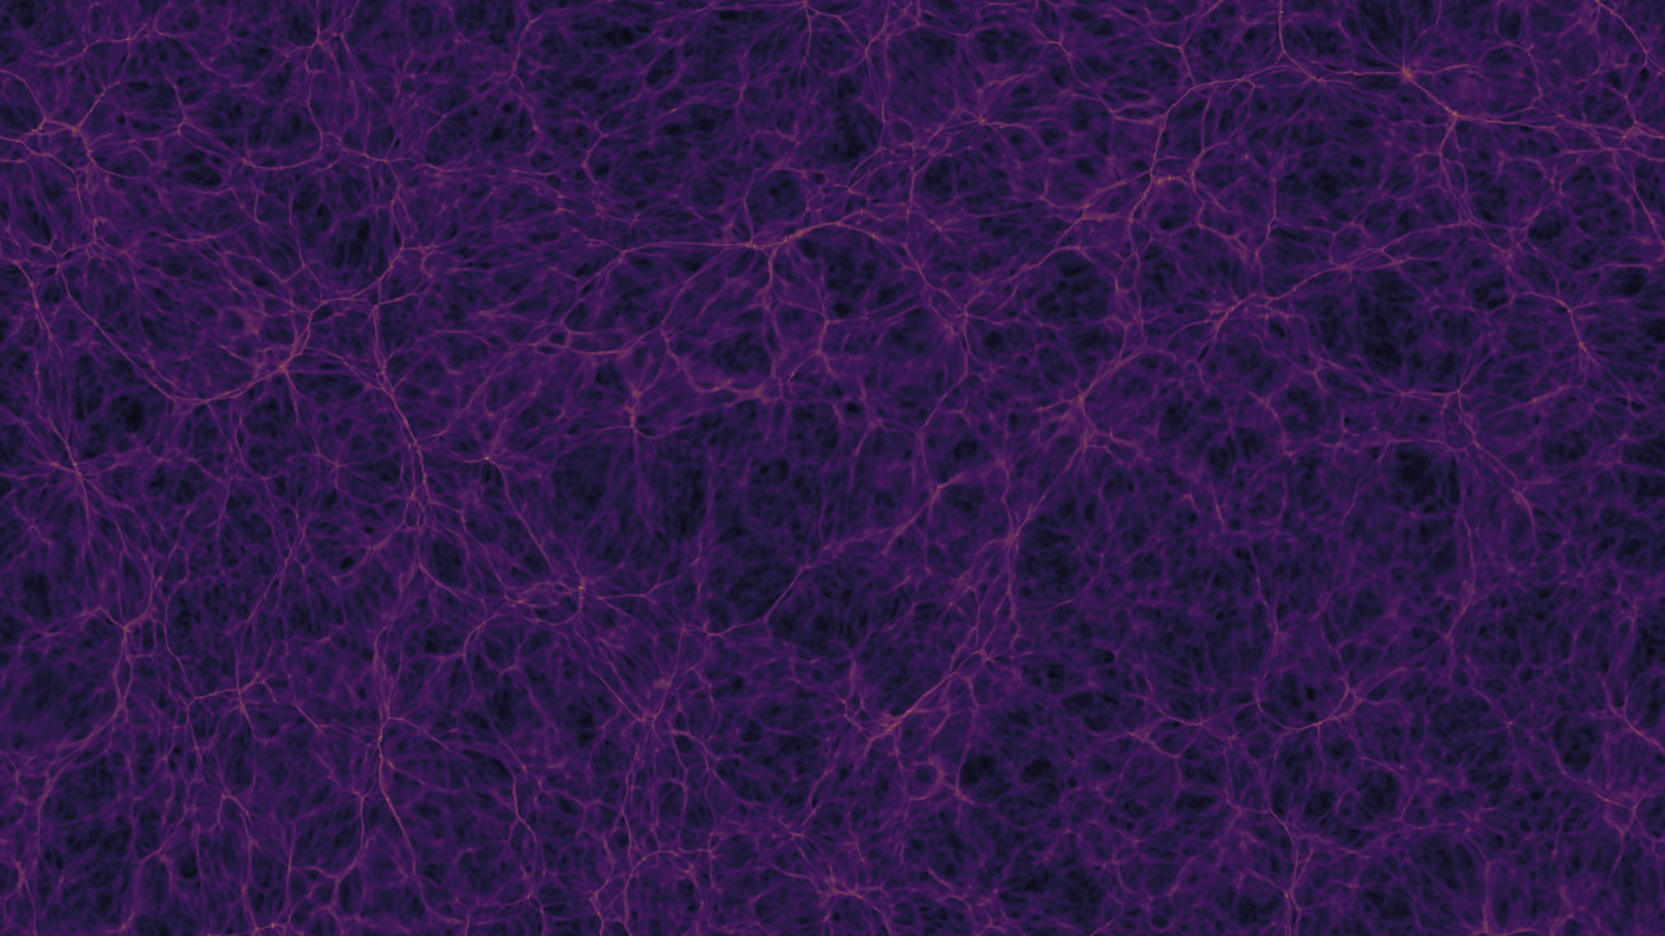
Gravitational Impact of the Death Star on Endor and Earth-like planets
A Scientific Exploration Using Newtonian Mechanics
By: Simon Tebeck, Pranav Gupta
Team Name: The Skywalkers
PI: Prof. Oliver Beckstein
https://github.com/Py4Phy/final-2024-the-skywalkers
Notes:
Minimum 9 minutes

Slide 2
Overview
This presentation delves into the phenomenon of [1]
Part 1: Pranav Gupta- Background and Motivation
Introduction
Ug
Part 2: Simon Tebeck- Results and Conclusions
SFR vs. Stellar Mass Across Redshifts
Galaxies y

Slide 3
Background
(WHY?): problem, equations to be solved, motivation

Slide 4
Methods
(HOW?): algorithms, parameters, code snippets, flow diagrams, object diagrams, libraries used, …

Slide 5
Results
(WHAT?): focus on graphs, images, tables, movies: show data (only little text to annotate data)

Slide 6
Conclusions
Summarize the work, what is the take home message? Did you fulfill your objectives?

Slide 7
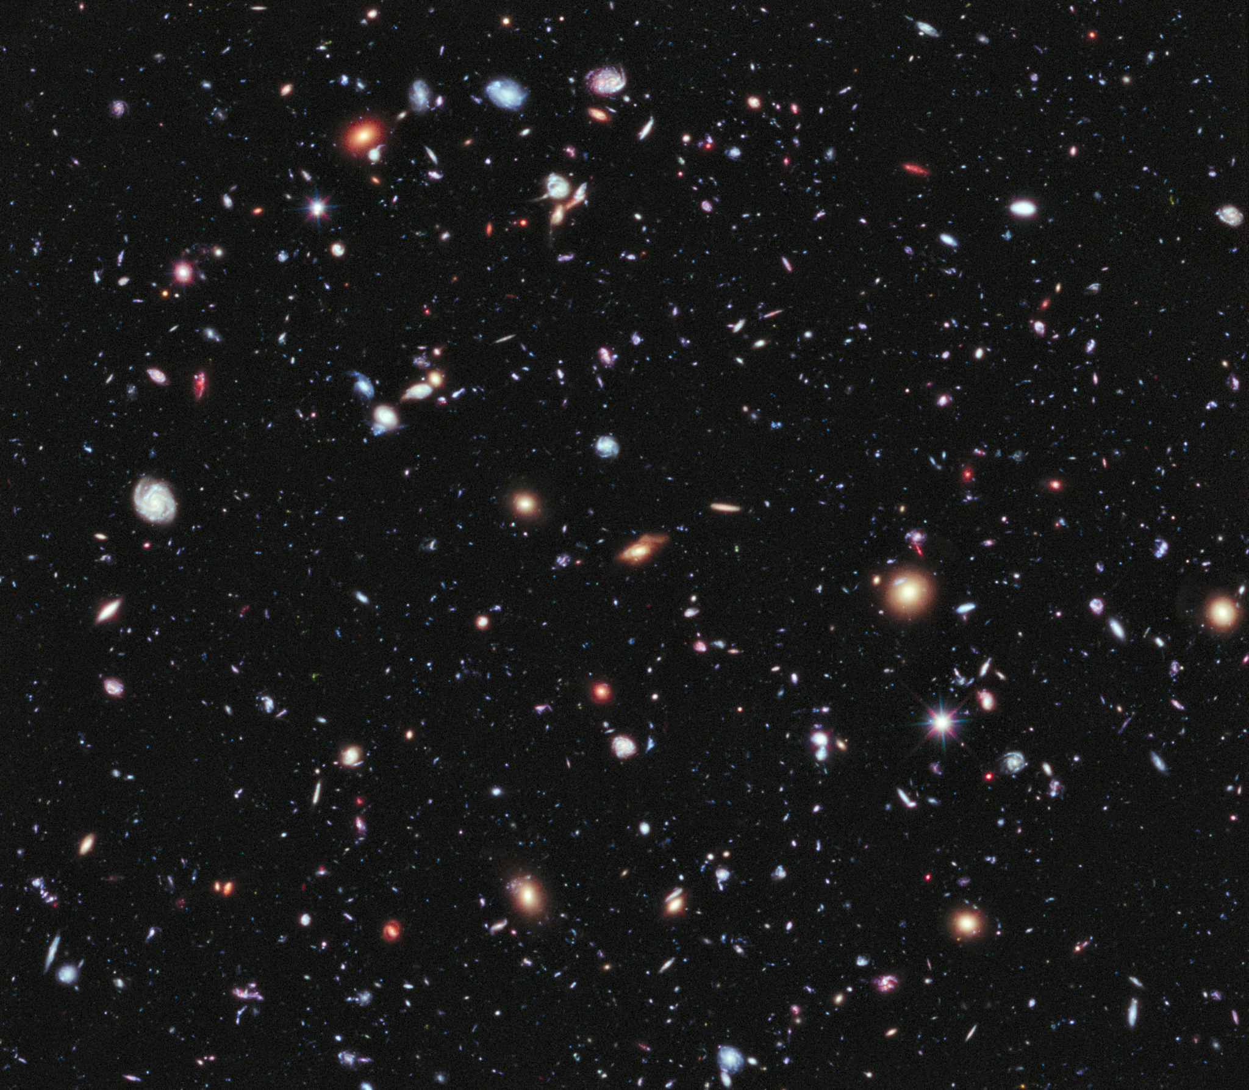
Future Work
Future work will focus on closely examining
These studies will help confirm whether.

Slide 8
Acknowledgement
Dome, T., et al.: Mini-Quenching of z = 4 − 8 Galaxies by Bursty Star Formation. arXiv:2305.07066v2

Slide 9
References
Dome, T., et al.: Mini-Quenching of z = 4 − 8 Galaxies by Bursty Star Formation. arXiv:2305.07066v2

Slide 10

Questions

Slide 11


